Slide 1

Inventory Management System
Streamlining Operations for Efficiency

Slide 2
Group Members & Contact Details Ankit Singh Negi – 7060174060, a9kit9egi@gmail.com Akash Arya- 7060011890, akash05ntl@gmail.com Suraj Pratap Singh – 7906656761, surajpratap9456@gmail.com Ashish Tiwari -9528869654, ashishtiwari95288@gmail.com Deepak Chandra Bahuguna – 9528482376, bahugunauk01@gmail.com

Slide 3

INTRODUCTION
An efficient inventory system not only helps in tracking inventory across various locations but also optimizes strategies, enhances operational efficiency, and improve import and exports of goods.
In an age of rapid technological advancement and globalization, effective inventory management can provide a significant competitive edge.

Slide 4
Objective
Automate store-related tasks for improved efficiency.
Introduce QR code-based inventory tracking for accuracy.
Integrate with an ERP system for seamless workflow management.

Slide 5
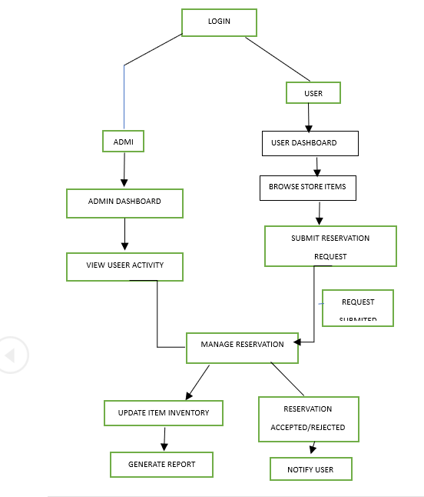
FLOWCHART OF IMS

Slide 6
ER Diagram

Slide 7
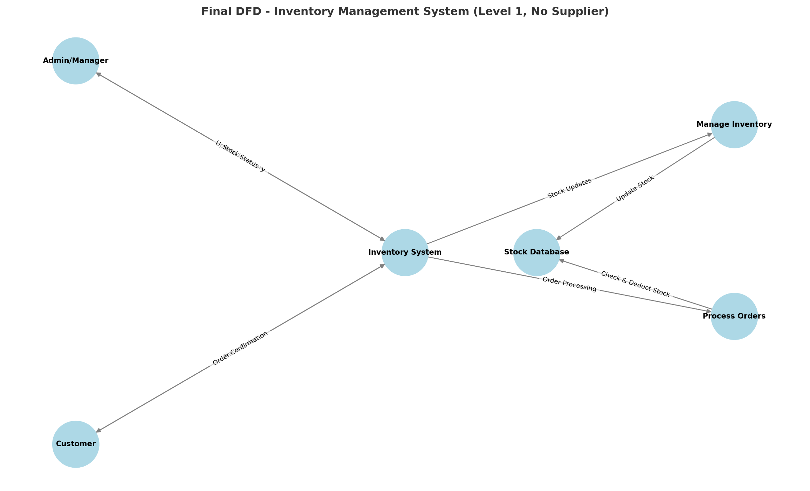
Data Flow Diagram

Slide 8
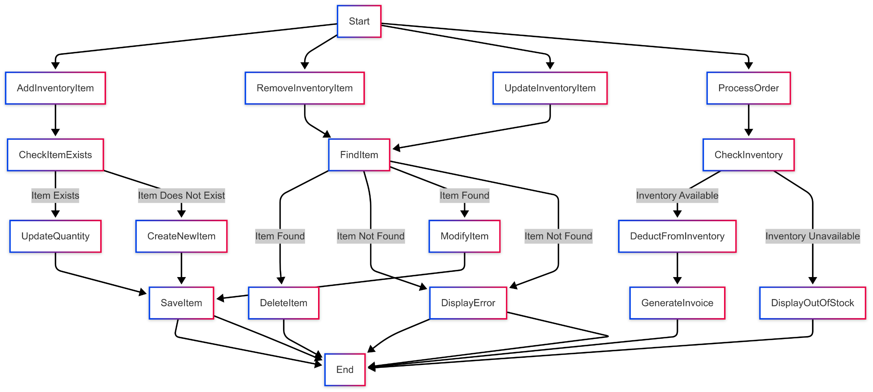
UML Diagram

Slide 9
Technologies Used
Frontend : HTML, CSS, Javascript, Bootstrap
Backend: Python, PHP
Database: MySQL

Slide 10
Project Progress
The Inventory management system project is 95% complete. The following tasks have been successfully completed:
User registration and login
User dashboard functionality
Item publishing and sharing
User ID and authentication systems are fully functional
The remaining 5% involves implementing the new Implementation Plans, including:
Delete functionality
Recipe generation

Slide 11
Income Revenue Generation (IRG)
This system can be extended to other institutions or training centers, where it can be offered for a one-time setup fee or a subscription-based model.

Slide 12

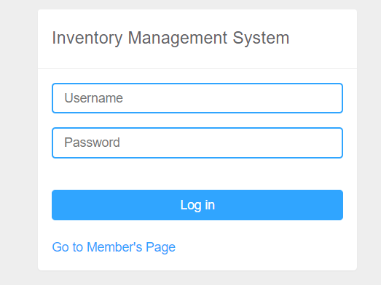
Users in inventory management system
Admin
Members

Slide 13
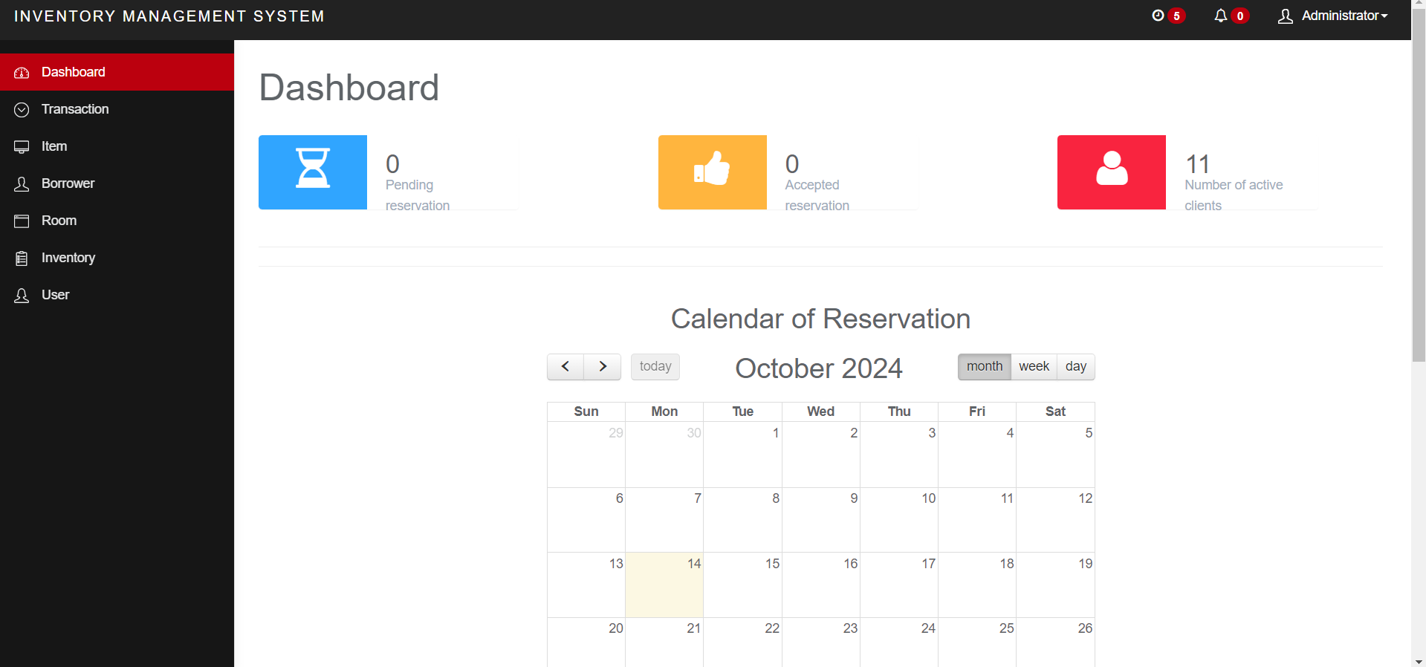
ADMIN DASHBOARD AFTER LOGIN
LANDING PAGE AFTER LOGIN

Slide 15
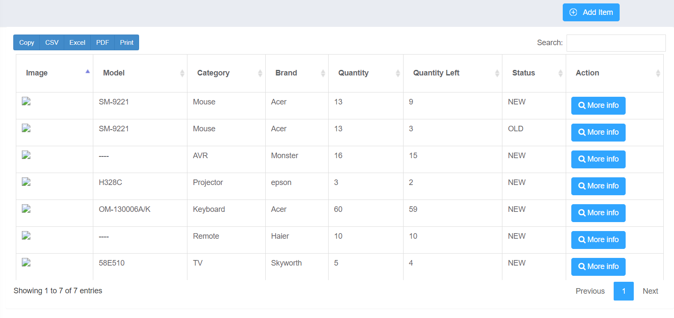
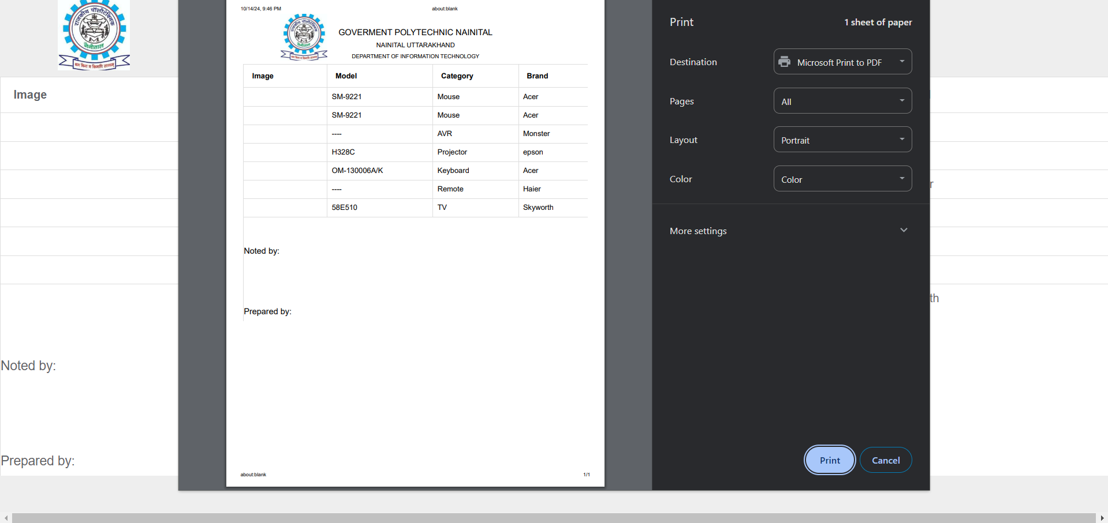
ADDING ITEM & PRINTING ITEM REPORT

Slide 16
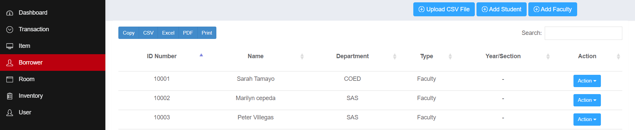
BORROWER'S DATA & FUNCTIONALITY
YOU CAN ACTIVATE AND DEACTIVATE THE USER BY USING ACTION BUTTON

Slide 17
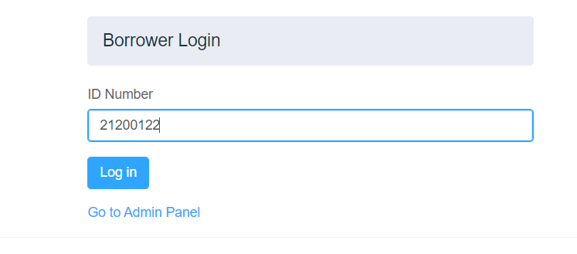
Member's login for borrowing items

Slide 18
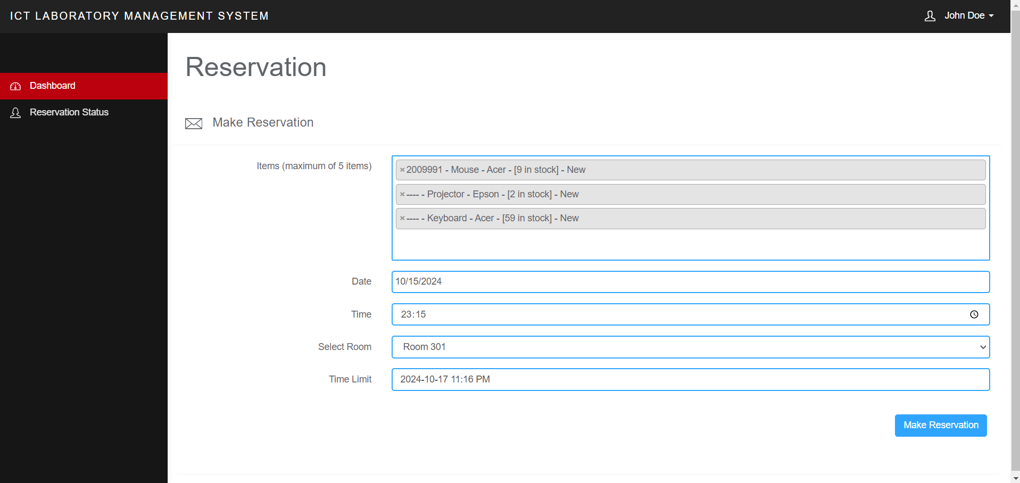

Slide 19
THANK YOU

